Slide 1
Wisconsin Gerrymandering
Christopher Maxel - Matthew Hapner

Slide 2
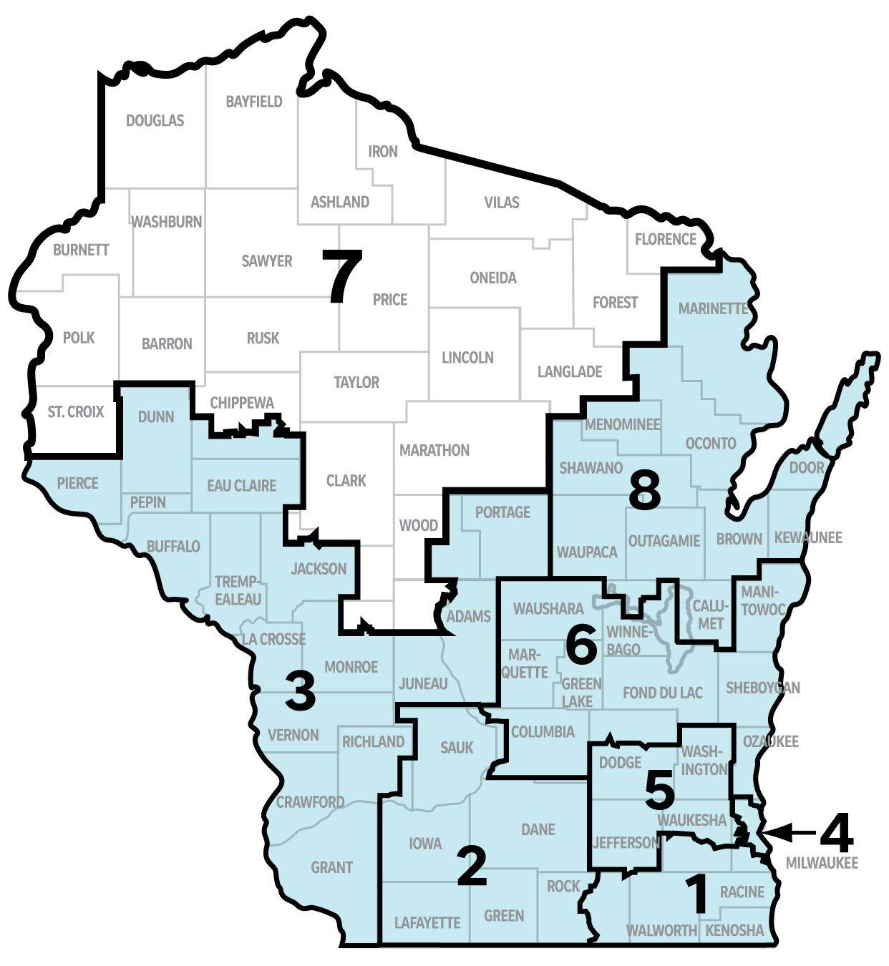
Wisconsin Overview
72 Counties
8 congressional districts
Accessible records

Slide 3
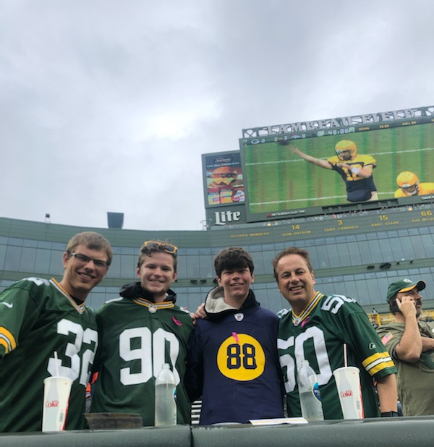

Why Wisconsin
Family and Friends live there
Special place for both of us
Go Pack Go!

Slide 4
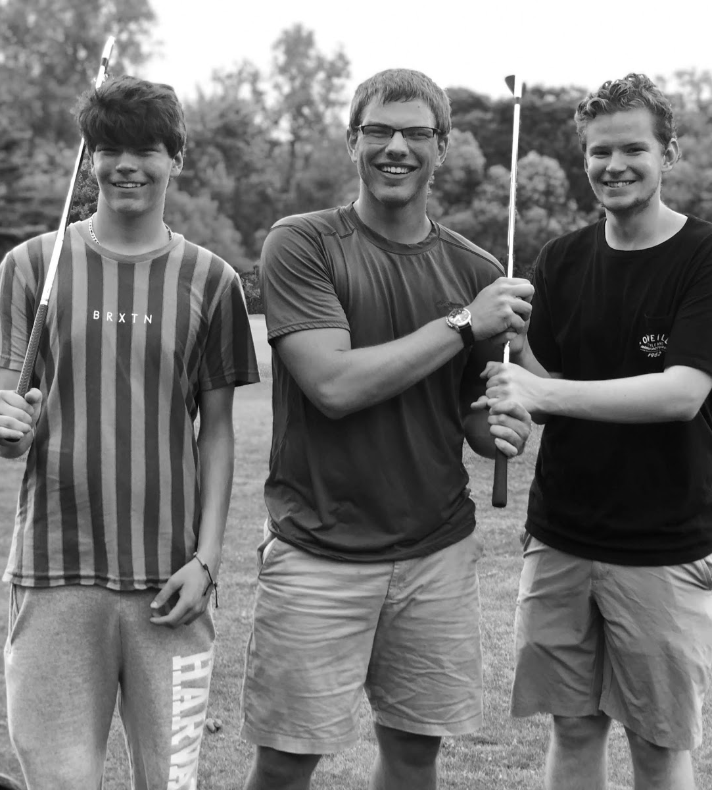
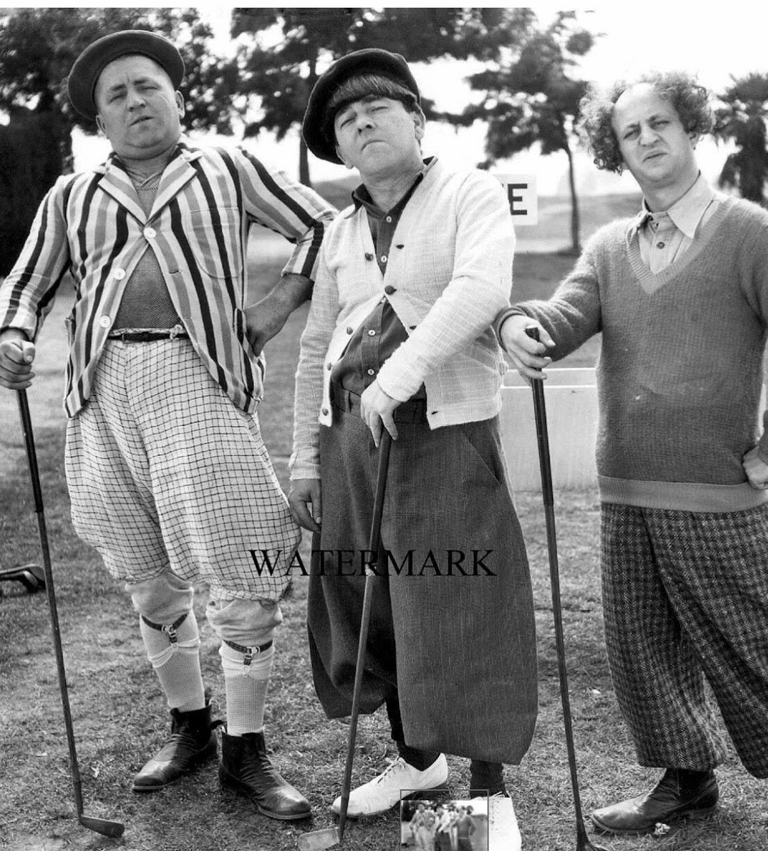

Slide 5
Attempt One

Slide 6
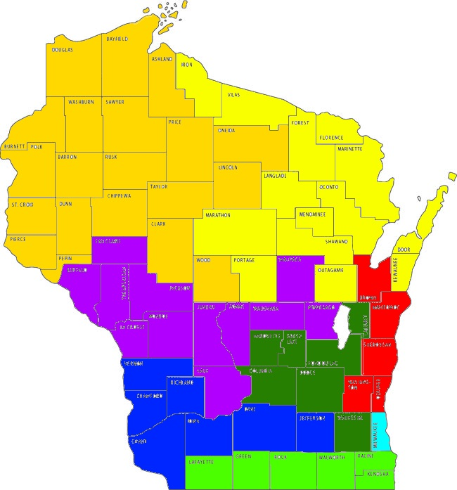
Map Attempt One
Seeded counties: Milwaukee, Sheboygan, Florence, Bayfield, Trempealeau, Grant, Rock, and Marquette
Spaced out around perimeter
Measure of fitness: 0.478
Minimax of district population: 284,497

Slide 7
Attempt Two

Slide 8
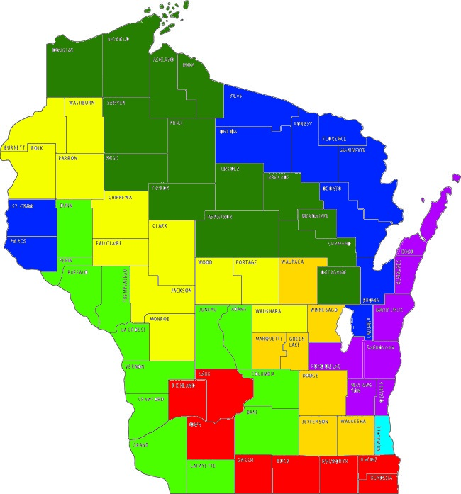
Map Attempt Two
Seeded counties: Milwaukee, Sauk, Jackson, Waupaca, Door, Forest, Dunn, Douglas
Spaced out; some central counties
Measure of fitness: 0.382
Minimax of district population: 396,065

Slide 9
Attempt Three

Slide 10
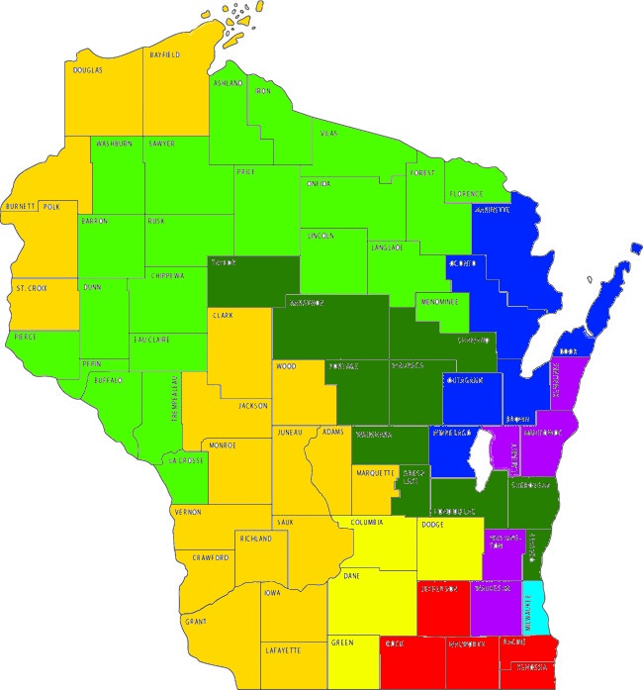
Map Attempt Three
Seeded counties: Milwaukee, Walworth, Green, Crawford, Manitowoc, Marinette, La Crosse, Taylor
More randomly chosen
Measure of fitness: 0.448
Minimax of district population: 288,906

Slide 11
Decision Tree

Slide 12
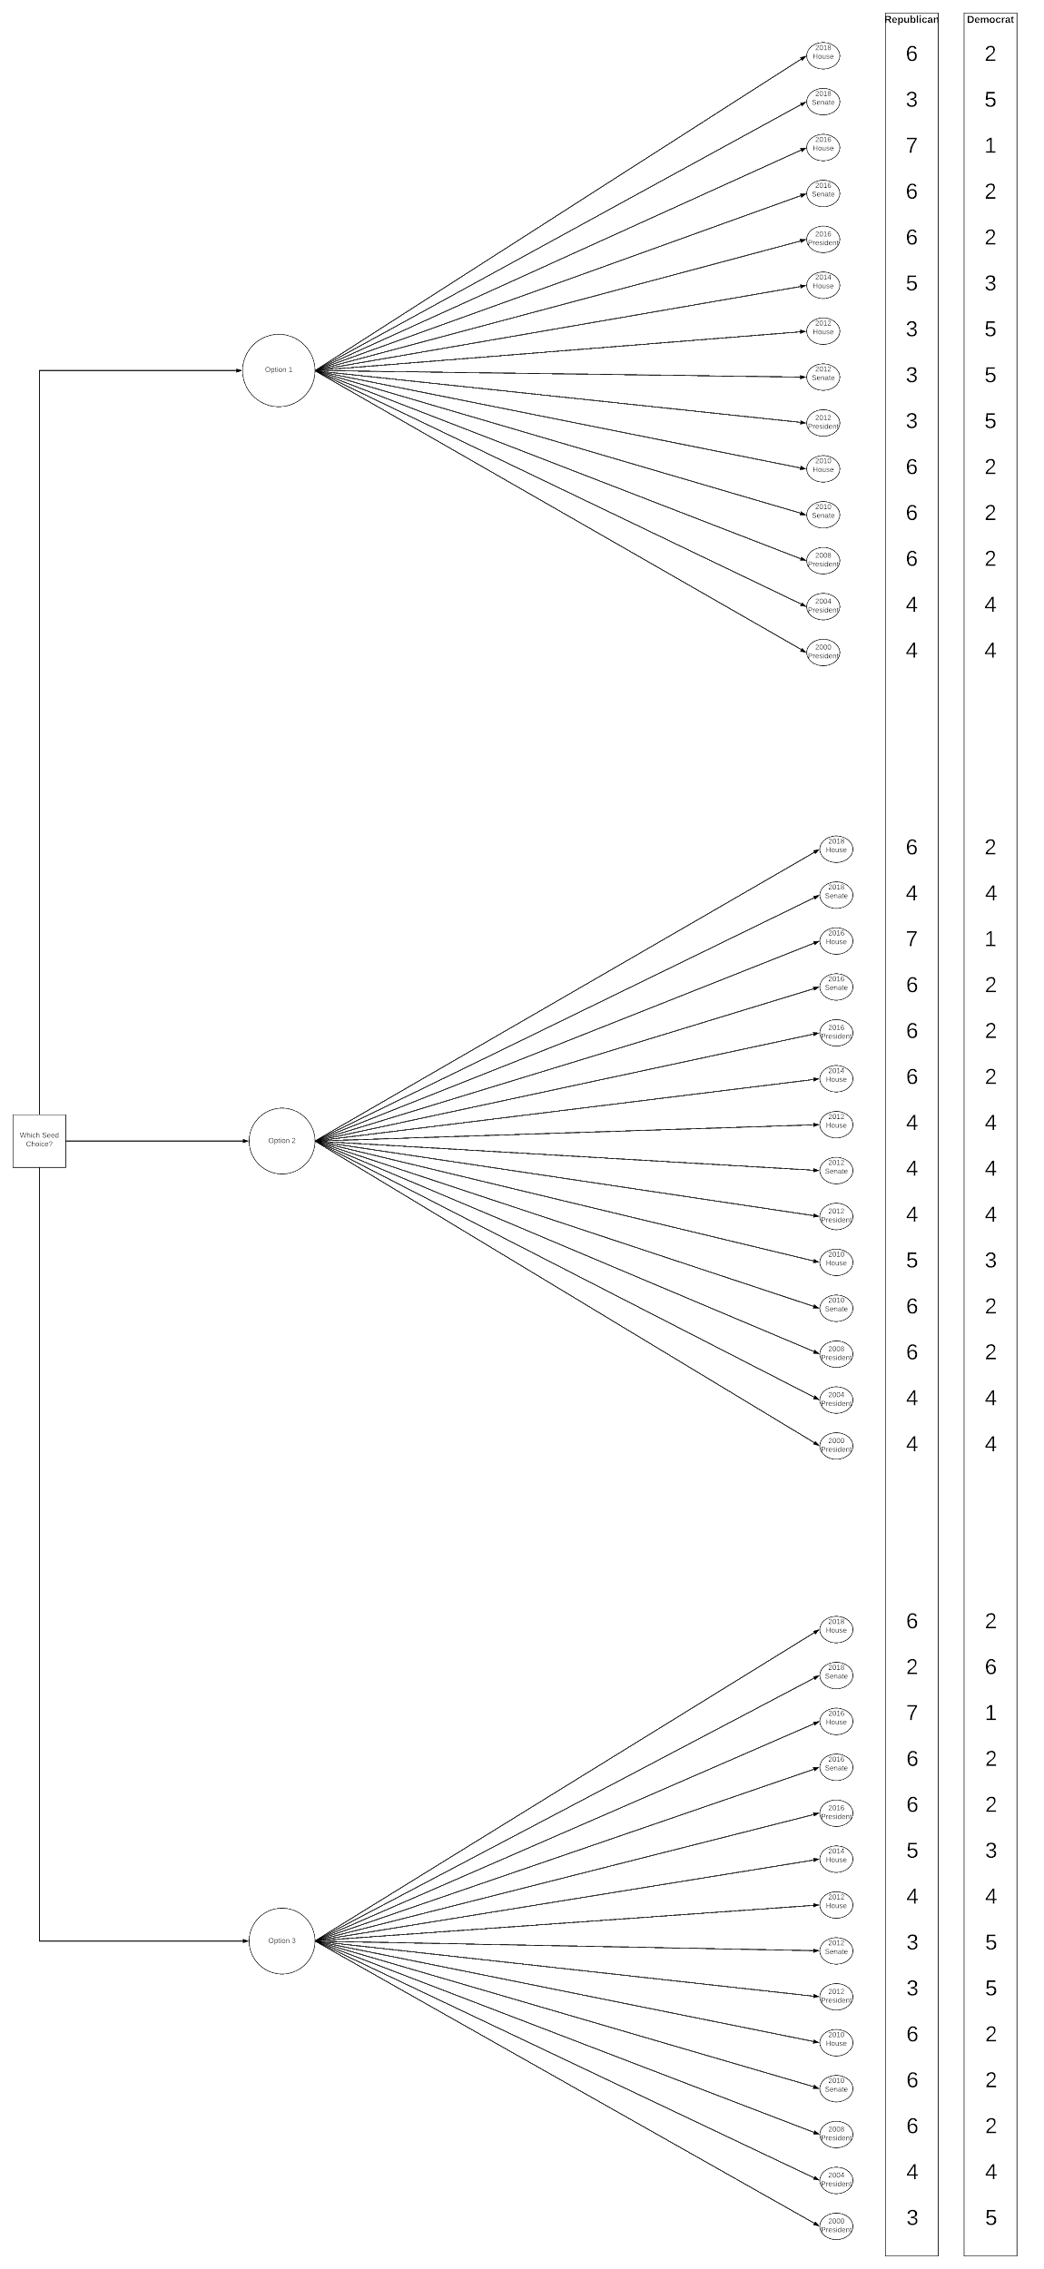
Decision Tree Attempt One
 | Republican | Democrat | Tie
Attempt 1 | 8 | 4 | 2

Slide 13
Decision Tree Attempt Two
 | Republican | Democrat | Tie
Attempt 2 | 8 | 0 | 6

Slide 14
Decision Tree Attempt Three
 | Republican | Democrat | Tie
Attempt 3 | 8 | 4 | 2

Slide 15
Analysis of Attempts

Slide 16
Best Choice by Political Party
Republicans
Option #2
Low regret
Best election results
Optimistic approach
Democrats
Option #3
Low regret
Optimistic and conservative approaches

Slide 17
Our Choice
Option #1
Minimizes regret for both parties
Visually contains the fewest “salamander” shaped districts
Smallest difference in district populations

Slide 18
Challenges and Successes

Slide 19
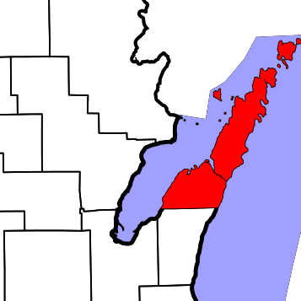
Challenges
Door county is a peninsula causing connection issues
Milwaukee county has ~950,000 people
Average district size is ~ 670,000 people
Had to make this a hardcoded seed

Slide 20

Successes
Data collection was quick and simple
We chose the best seeds in our first attempt
Most of the districts are contiguous (few exceptions)

